Slide 1

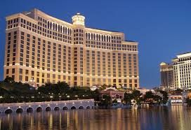

Hotel Reservation Analysis Using Structured Query Language (SQL)
By
Nzurumike Obianuju Lynda (Ph.D.)

Slide 2
INTRODUCTION
The hotel industry relies on data to make informed decisions and improve its guest experience. In this internship project, I worked with a hotel reservation dataset. I used SQL to query and analyze the data to gain insights into guest preferences, booking trends, and other important factors that affect the hotel's operations. Additionally, I answered specific questions about the dataset.

Slide 3
Dataset Description
The dataset includes the following columns:
Booking_ID: A unique identifier for each hotel reservation.
no_of_adults: The number of adults in the reservation.
no_of_children: The number of children in the reservation.
no_of_weekend_nights: The number of nights in the reservation that fall on weekends.
no_of_week_nights: The number of nights in the reservation that fall on weekdays.
type_of_meal_plan: The meal plan chosen by the guests.
room_type_reserved: The type of room reserved by the guests.
lead_time: The number of days between booking and arrival.
arrival_date: The date of arrival.
market_segment_type: The market segment to which the reservation belongs.
avg_price_per_room: The average price per room in the reservation.
booking_status: The status of the booking.

Slide 4
Questions
1. What is the total number of reservations in the dataset?
2. Which meal plan is the most popular among guests?
3. What is the average price per room for reservations involving children?
4. How many reservations were made for the year 20XX (replace XX with the desired year)?
5. What is the most commonly booked room type?
6. How many reservations fall on a weekend (no_of_weekend_nights > 0)?
7. What is the highest and lowest lead time for reservations?
8. What is the most common market segment type for reservations?
9. How many reservations have a booking status of "Confirmed"?
10. What is the total number of adults and children across all reservations?
11. What is the average number of weekend nights for reservations involving children?
12. How many reservations were made in each month of the year?
13. What is the average number of nights (both weekend and weekday) spent by guests for each room type?
14. For reservations involving children, what is the most common room type, and what is the average price for that room type?
15. Find the market segment type that generates the highest average price per room.

Slide 5
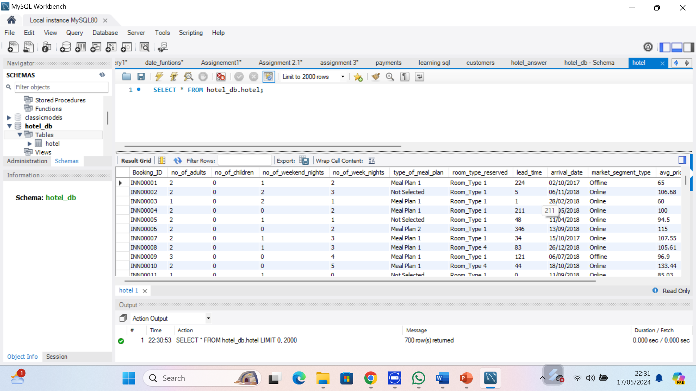

Import the CSV file to MYSQL workbench
The dataset was imported to MySQL. The database schema was saved as hotel.db and the table as hotel. The dataset has 700 records as shown in the screenshot below

Slide 6
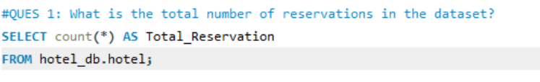

Question 1: What is the total number of reservations in the dataset?

Slide 7
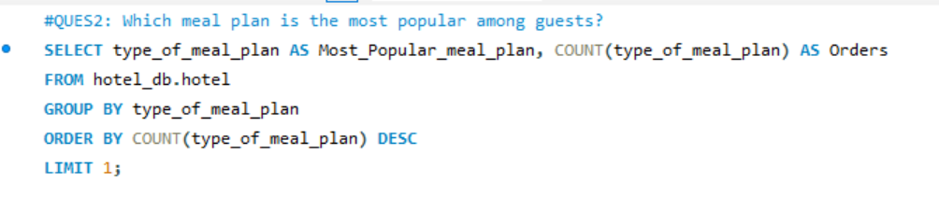
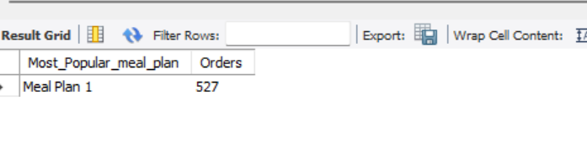
Question 2: Which meal plan is the most popular among guests?

Slide 8
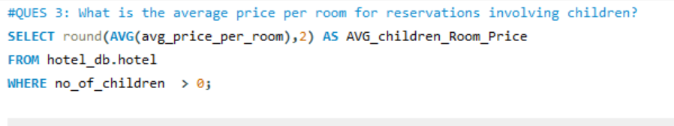
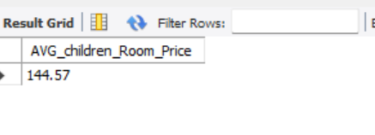
Question 3: What is the average price per room for reservations involving children?

Slide 9
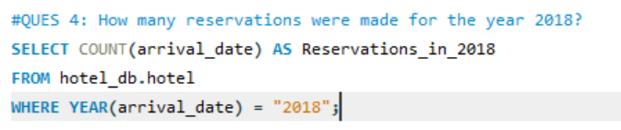
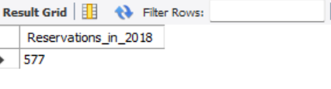
Question 4: How many reservations were made for the year 2018?

Slide 10
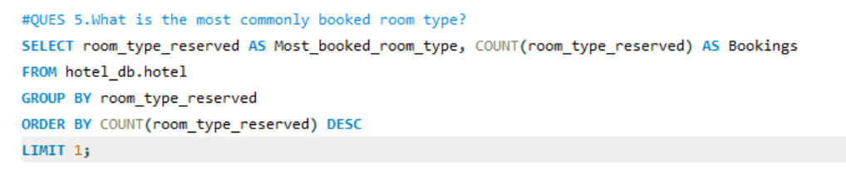
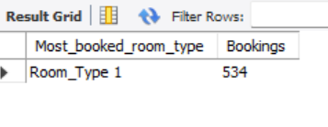
Question 5: What is the most commonly booked room type?

Slide 11
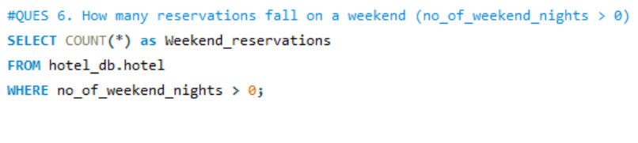
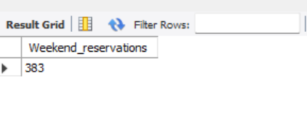
Question 6: How many reservations fall on a weekend (no_of_weekend_nights > 0)?

Slide 12
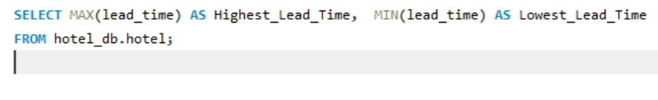
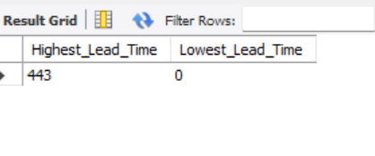
Question 7: What is the highest and lowest lead time for reservations?

Slide 13
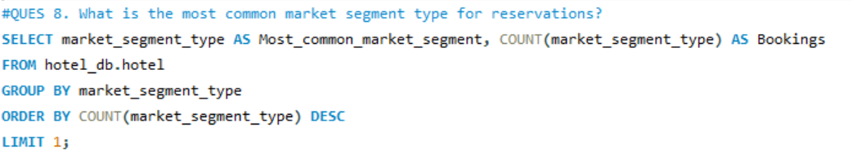
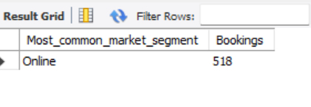
Question 8: What is the most common market segment type for reservations?

Slide 14
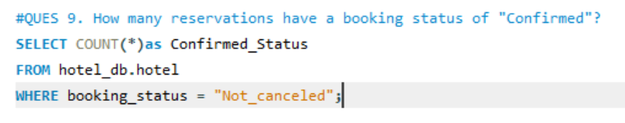
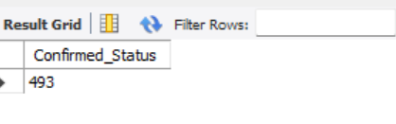
Question 9: How many reservations have a booking status of "Confirmed"?

Slide 15
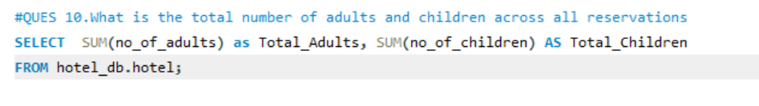
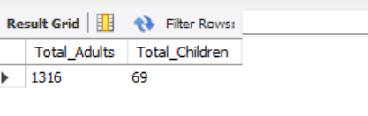
Question 10: What is the total number of adults and children across all reservations?

Slide 16
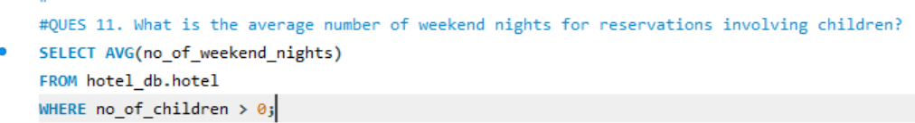
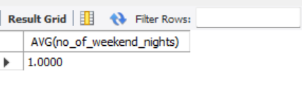
Question 11: What is the average number of weekend nights for reservations involving children?

Slide 17
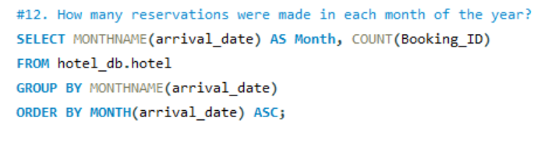
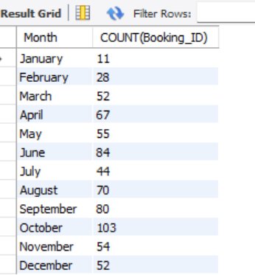
Question 12: How many reservations were made in each month of the year?

Slide 18
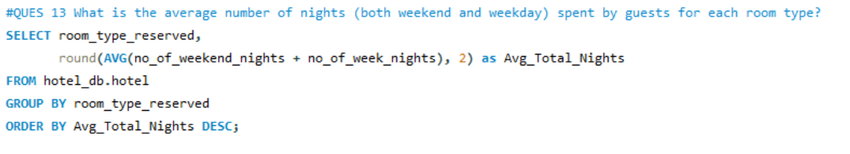
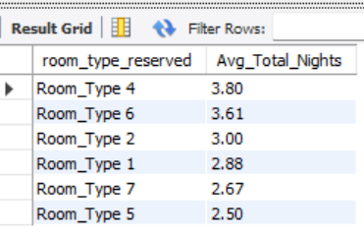
Question 13: What is the average number of nights (both weekend and weekday) spent by guests for each room type?

Slide 19
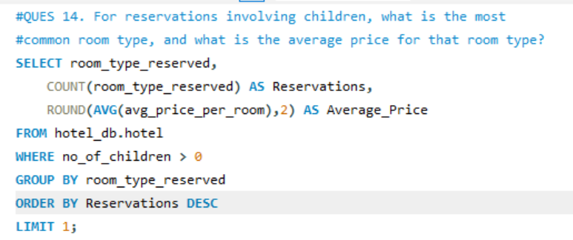
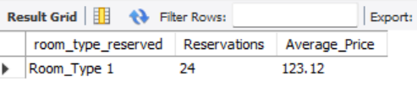
Question 14: For reservations involving children, what is the most common room type, and what is the average price for that room type?

Slide 20
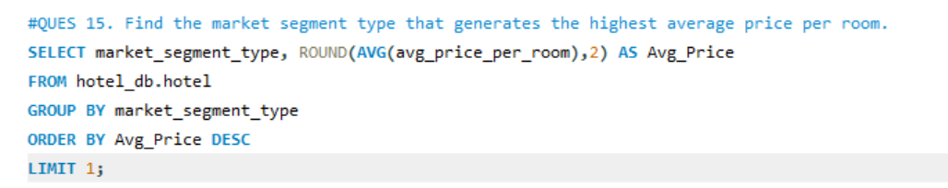
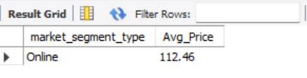
Question 15: Find the market segment type that generates the highest average price per room.?

Slide 21
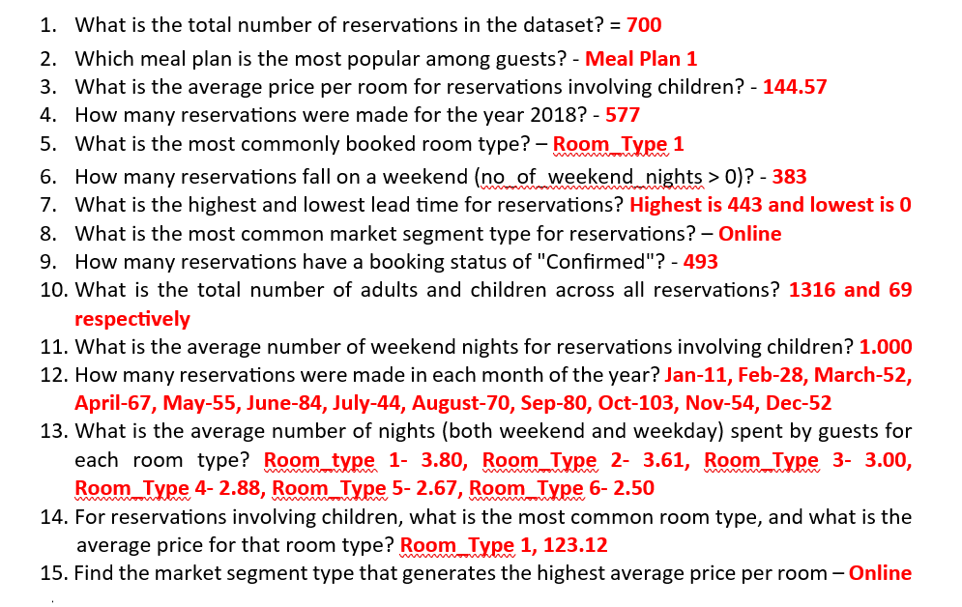
Solutions to the questions

Slide 22



www.linkedin.com/in/uju-nzurumike
nzurumikeuju2@gmail.com

